Slide 1
Data Mining DS-303
Lecture 2
Muhammad Arham
Lecturer
The University of Faisalabad

Slide 2
Content
K-Mean and K-Median Clustering

Slide 3
K-Median Clustering

Slide 4
K-Median Clustering Algorithm
Data Mining / Machine Learning
Unsupervised Learning Technique

Slide 5
Introduction
K-Median is a clustering algorithm used in data mining
It divides an unlabeled dataset into K clusters
Each cluster is represented by its median (center point)
It is similar to K-Means but more robust to noise

Slide 6
What is Median?
Median = middle value of a sorted dataset
Example:
Data = {2, 4, 6, 8, 100}
Median = 6
Less affected by extreme values (outliers)

Slide 7
Objective of K-Median
Minimize the sum of distances between data points and their cluster medians
Assign each point to the nearest median
Produce compact and well-separated clusters

Slide 8
Key Characteristics
Uses median instead of mean
Typically uses Manhattan distance
More robust to outliers than K-Means
Works well with noisy datasets

Slide 9
Algorithm Steps
Choose the number of clusters K
Select initial medians randomly
Assign each data point to the nearest median
Recalculate medians for each cluster
Repeat steps 3–4 until clusters do not change

Slide 10

Distance Measure
Uses Manhattan Distance (L1 norm)
Formula:
Measures distance along axes (grid-based path)

Slide 11
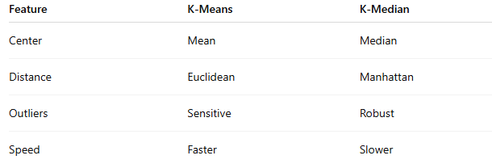
K-Means vs K-Median

Slide 12
Advantages
Less sensitive to outliers and noise
Produces more stable clusters
Suitable for skewed data distributions

Slide 13
Disadvantages
Computationally more expensive
Slower convergence than K-Means
Not as widely used or supported

Slide 14
Applications
Customer segmentation
Image processing
Pattern recognition
Data analysis with noisy datasets

Slide 15
Example
Dataset: (2,3), (3,4), (10,12), (11,13)
If K = 2:
Cluster 1 → (2,3), (3,4) → Median ≈ (2.5, 3.5)
Cluster 2 → (10,12), (11,13) → Median ≈ (10.5, 12.5)

Slide 16
Advice
Kindly read the book before and after the lecture, if some terms/ words are not covered in the lecture like K-Medoids, if appear in exam it might not appear strange or out of course.

